Slide 1

Ein FabLab im Oberland
Notes:
1

Slide 2
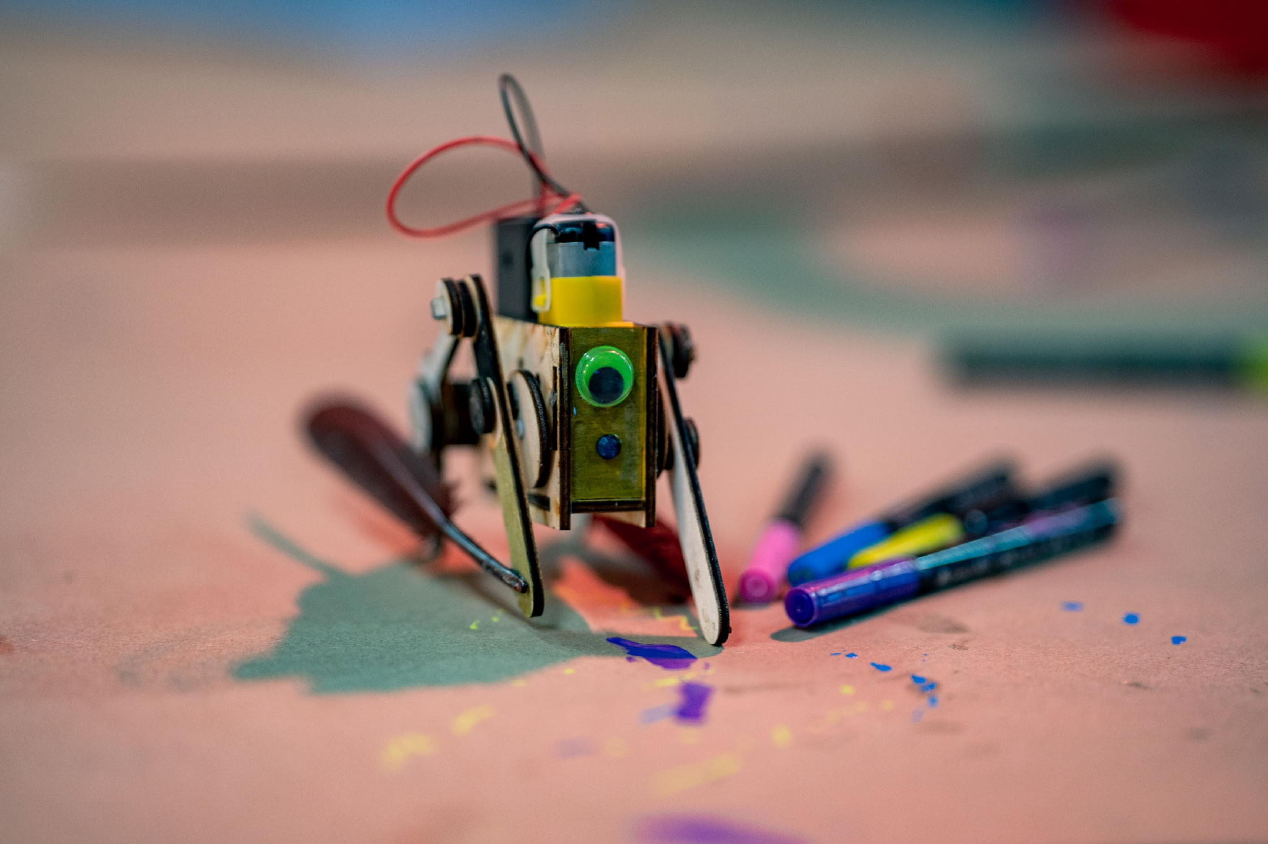
Egone
The Robopet
2

Slide 3
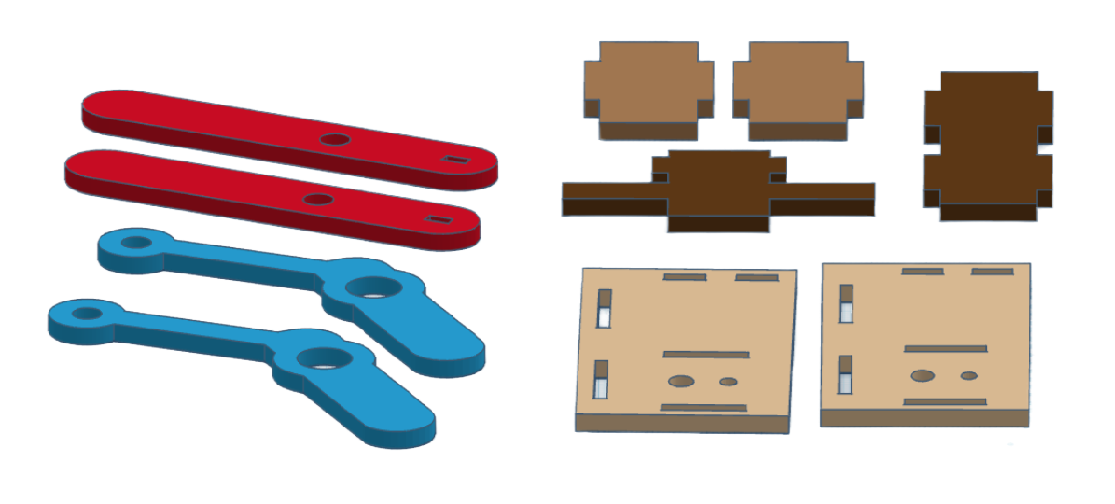
Egone
Partslist
3
Notes:
Parts are glued in advance to give more stability

Slide 4
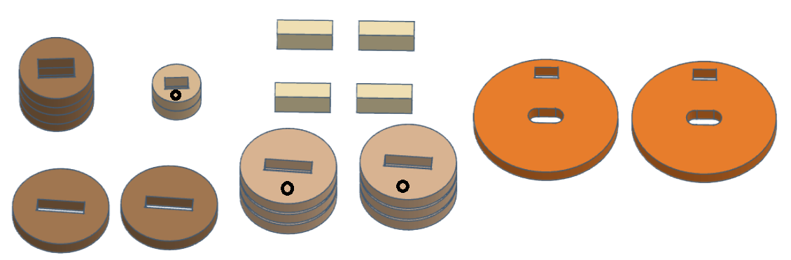
Egone
4x
2x
Partslist
4x
2x 6x
2x
4
Notes:
Parts are glued in advance to give more stability

Slide 5
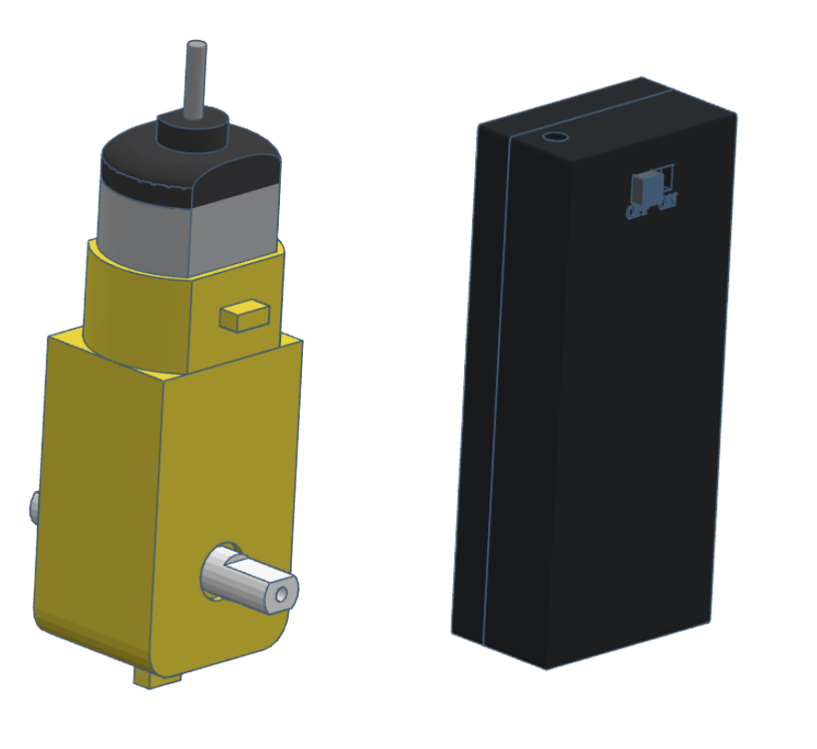

Egone
Partslist
5
Notes:
Parts are glued in advance to give more stability

Slide 6
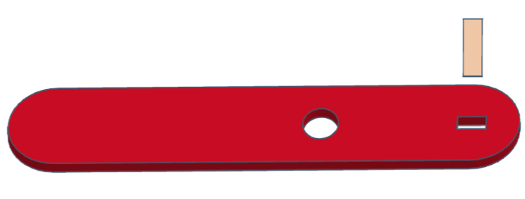
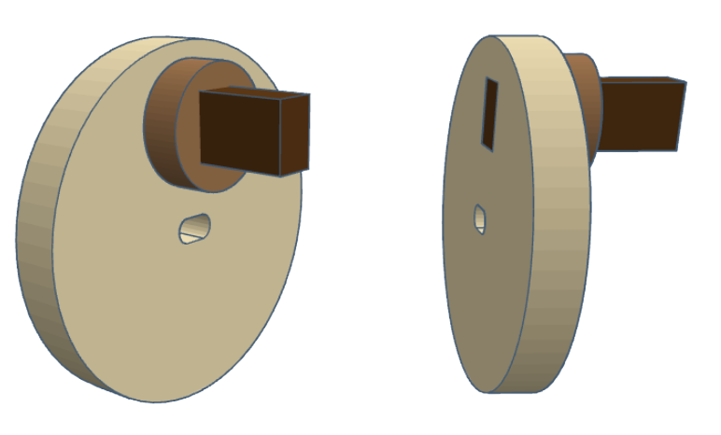
Roboterhaustier
Glue the 3 parts together
Use the small part with marking

Slide 7
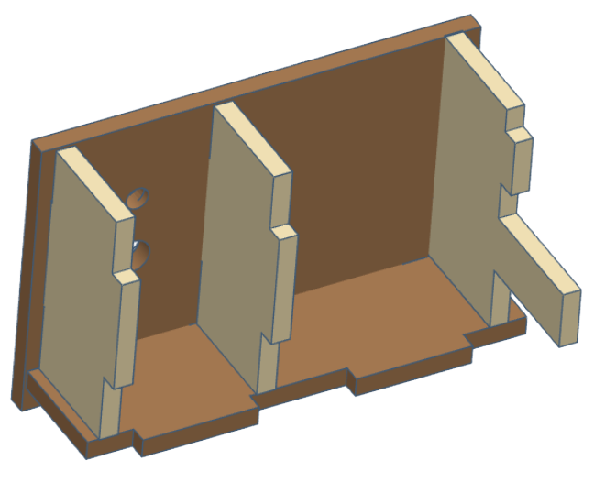
Roboterhaustier
The assembly of the body

Slide 8
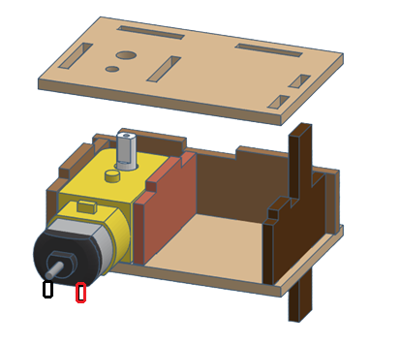
Egone
The assembly of the body
8

Slide 9
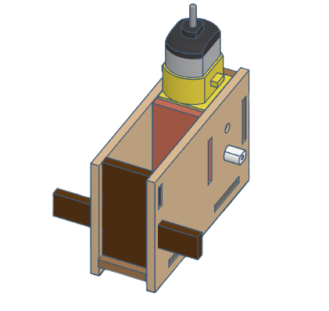
Egone
The assembly of the body
9

Slide 10
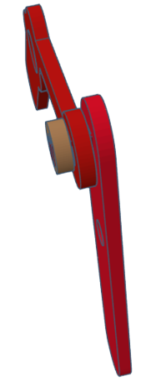
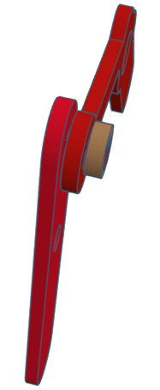
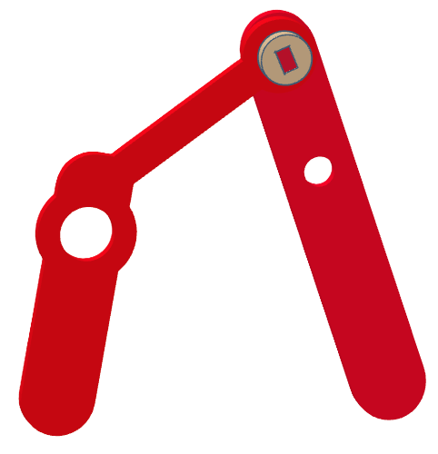
Roboterhaustier
Watch that the feets can move freely
No Glue
on the inside!
The feets must be mirrored.

Slide 11
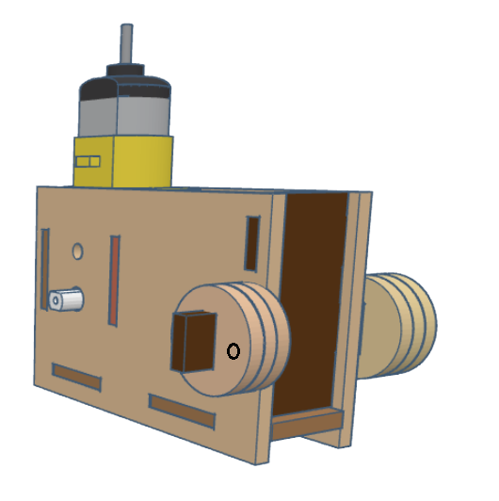
Egone
Use the spacers
with marking
and glue the parts together
on both sides
No Glue
on the outside!
11

Slide 12
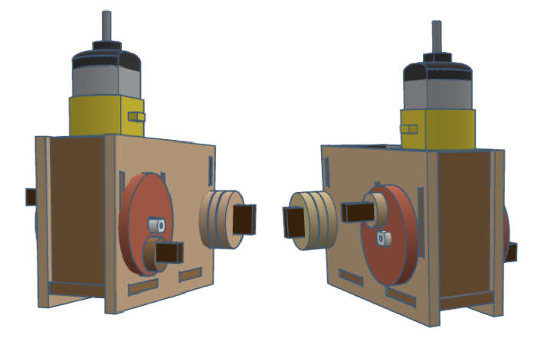


Egone
Install the eccentrics
offset by 180°
To the engine
12

Slide 13
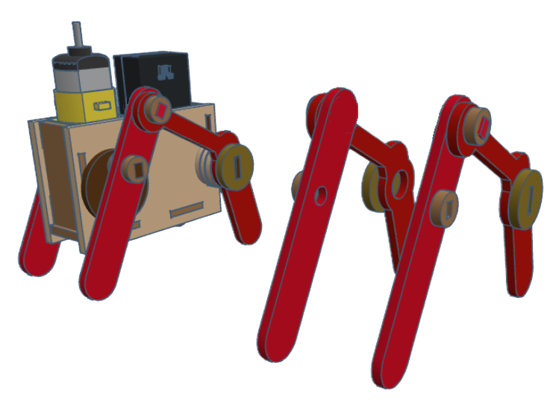
Egone
Assemble the feet
to the body
13

Slide 14
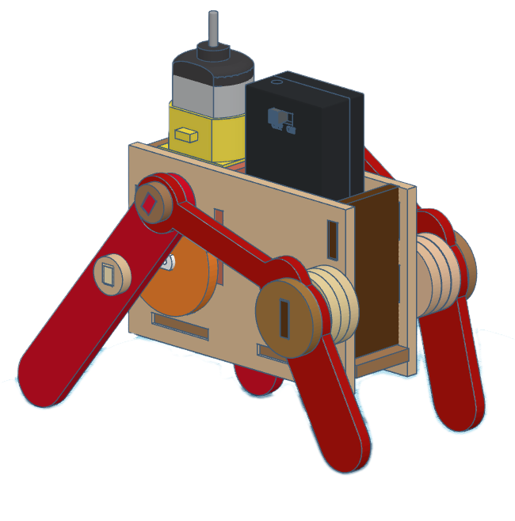
Egone
Insert the battery holder and solder the cables to the motor
14

Slide 15
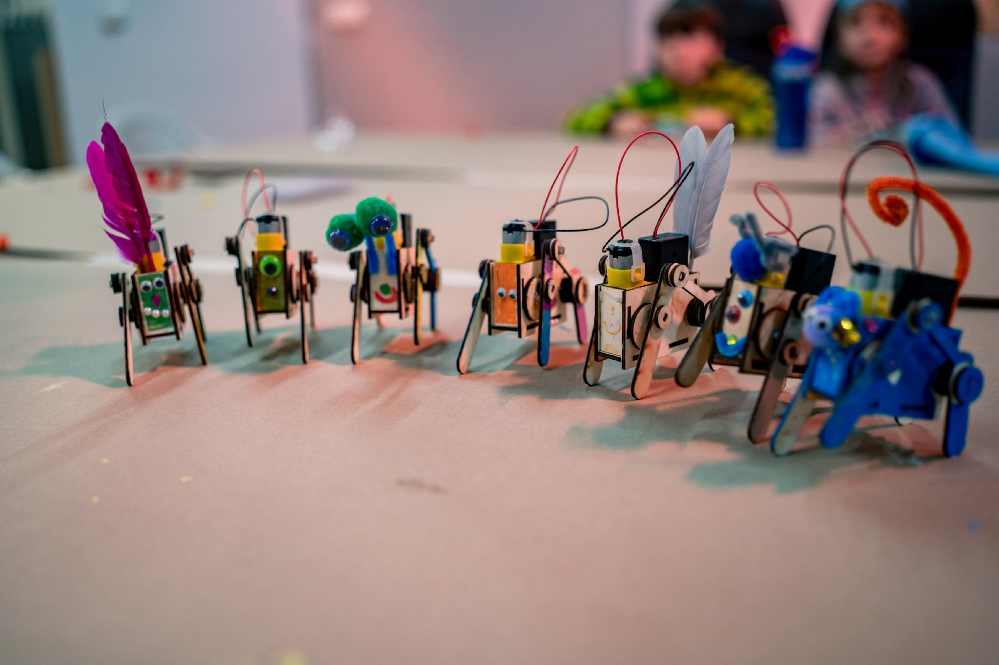
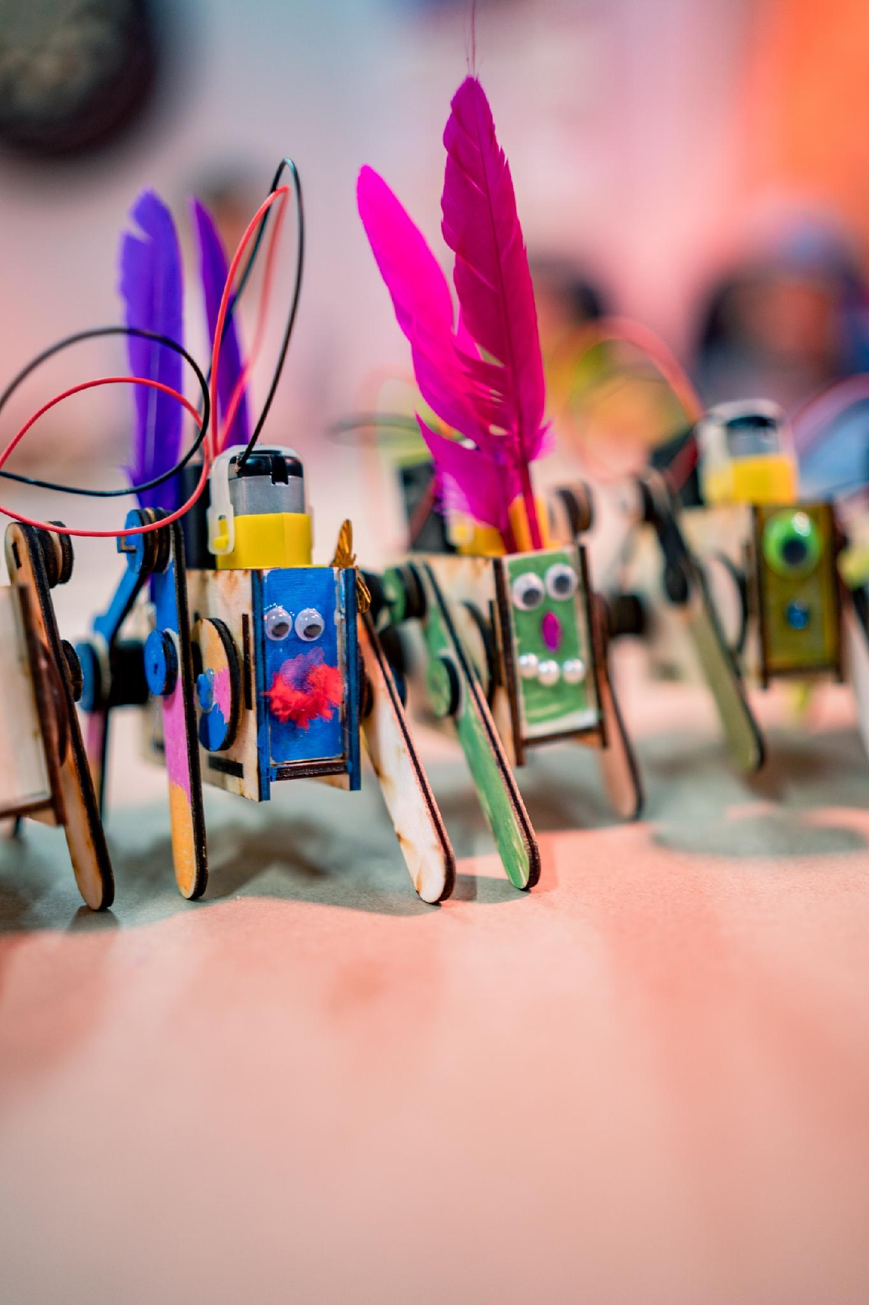
Egone
Now Pimp your
Robopets
Do not discard batteries
in household waste!
15

